Slide 1

MA2011 MECHATRONICS SYSTEMS INTERFACING
Lecture 2
Prof. Cai Yiyu
College of Engineering
School of Mechanical and Aerospace Engineering

Slide 2
Recap of Lecture 1

Slide 3
Recap of Lecture 1
Mechatronics & Mechatronics System
Mechatronics =
Mechanical System + Electronic System + Control System + Computer
Three Characteristics of A Good Measurement System
Amplitude linearity, phase linearity and adequate bandwidth
Fourier Series Representation
We showed that a periodical square signal can be represented by
a Fourier series

Slide 4
Insights of Lecture 2 - Fourier Series Method

Slide 5
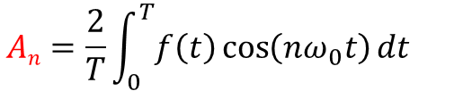
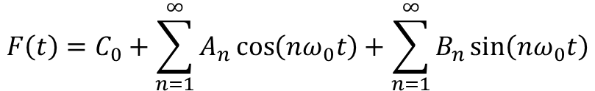
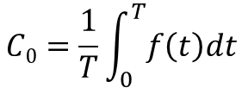
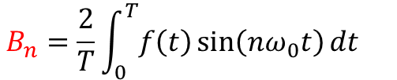
FOURIER SERIES REPRESENTATION OF SIGNALS
The Fourier series representation of a periodical waveform f(t) is
$$F\left(t\right)=C_{0}+\sum_{n=1}^{∞}{A_{n}\cos\left(nω_{0}t\right)+\sum_{n=1}^{∞}{B_{n}\sin\left(nω_{0}t\right)}}$$
Where C₀ is the DC component of the signal and
A_{n} and B_{n} are coefficients.
$$C0=\frac{1}{T}\int_{0}^{T}{f\left(t\right)dt}$$
$$An=\frac{2}{T}\int_{0}^{T}{f\left(t\right)\cos\left(nω_{0}t\right)dt }$$
$$B_{n}=\frac{2}{T}\int_{0}^{T}{f\left(t\right)\sin\left(nω_{0}t\right)dt }$$

Slide 6
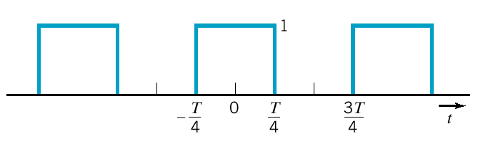


















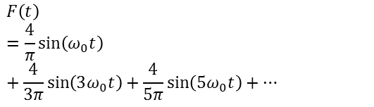




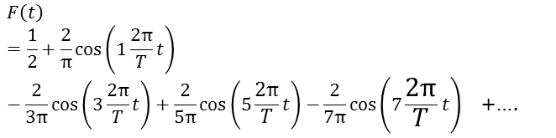




Calculation of the Fourier Coefficients
Square wave decomposition
Square wave decomposition
$$f(t)$$
$$1$$
$$t$$
$$1$$
$$1$$
$$\frac{1}{2}$$
$$\frac{2}{π}$$
$$\frac{4}{π}$$
$$\frac{2}{3π}$$
$$\frac{2}{5π}$$
$$\frac{4}{3π}$$
$$\frac{4}{5π}$$
$$0$$
$$0$$
$$f$$
$$2f$$
$$3f$$
$$4f$$
$$5f$$
$$6f$$
$$0$$
$$f$$
$$2f$$
$$3f$$
$$4f$$
$$5f$$
$$6f$$
$$F\left(t\right)=\frac{1}{2}+\frac{2}{π}\cos\left(1\frac{2π}{T}t\right)−\frac{2}{3π}\cos\left(3\frac{2π}{T}t\right)+\frac{2}{5π}\cos\left(5\frac{2π}{T}t\right){−\frac{2}{7π}\cos\left(7\frac{2π}{T}t\right)}_{}\text{+….}$$
$$F\left(t\right)=\frac{4}{π}\sin\left(ω_{0}t\right)+\frac{4}{3π}\sin\left(3ω_{0}t\right)+\frac{4}{5π}\sin\left({5ω}_{0}t\right)+…$$

Slide 7
WHY FOURIER SERIES REPRESENTATION OF A SIGNAL?
1
To study bandwidth and phase linearity (applied to frequency components of an input signal)
2
Any periodical waveform can be represented as an infinite series of sine and cosine waveforms of different amplitudes and frequencies
3
Summing up this infinite series gives the original periodical waveform
Practically, a finite number of the sine and cosine waveforms can adequately represent a periodical waveform
4

Slide 8
Spectrum & Measurement System
1
It is important to estimate the spectrum of a signal when choosing a measurement system
2
An ideal measurement system replicates all frequency components of an input signal
A practical measurement system has limitations in reproducing all frequencies
3

Slide 9
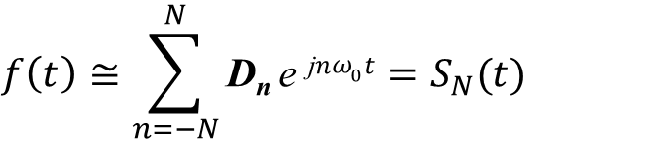
Error of Approximation
A practical calculation of the Fourier series requires that we truncate the series to a finite number of terms.
$$f\left(t\right)≅\sum_{n=−N}^{N}{\text{D}\text{n} \text{e} \text{j}nω_{0}t}=S_{N}(t)$$
The error for N terms is
We use the mean-square error (MSE) defined as
MSE is minimum when D_{n} = Fourier series’ coefficients

Slide 10
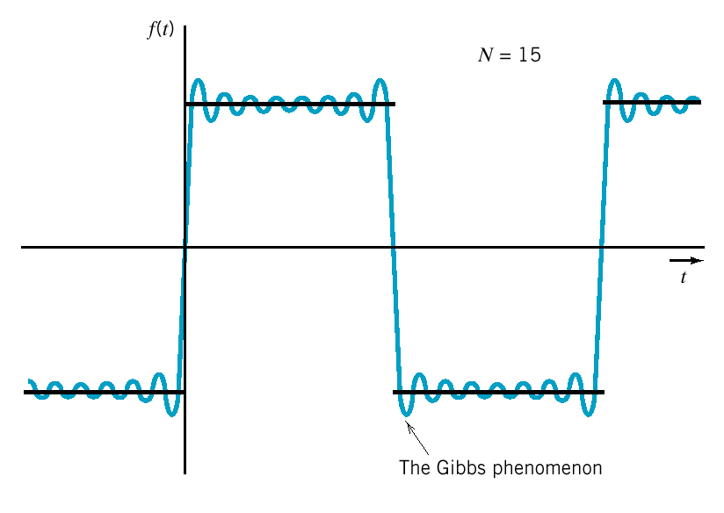
Error of Approximation
overshoot

Slide 11

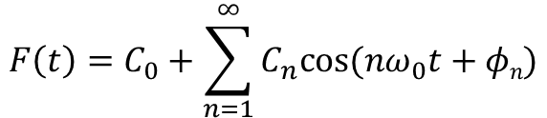
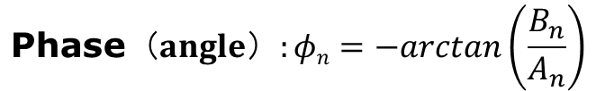
Amplitude and Phase
Based on the cosine form of Fourier series
$$F\left(t\right)=C_{0}+\sum_{n=1}^{∞}{C_{n}cos⁡(nω_{0}t+φn)}$$
That is, a period waveform can be represented by an infinite series of cosine of single amplitude and phase
$${\text{S}\text{ingle} \text{amplitude}: C}_{n}=\sqrt{{A_{n}}^{2}+{B_{n}}^{2}}$$
$$\text{p}\text{hase}（angle）:φn=−arctan\left(\frac{B_{n}}{A_{n}}\right)$$

Slide 12



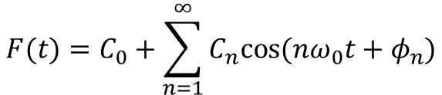
Amplitude, Frequency, and Phase
$$F(t)=C_{0}+\sum_{n=1}^{∞}{C_{n}cos⁡(nω_{0}t+φ_{n})}$$
DC: C₀ is the average value of f(t)
The n^{th} harmonic amplitude: C_{n} The fundamental frequency: ω₀ The n^{th} fundamental frequency: n ω₀ The n^{th} phase angle:
$$φ_{n}=−arctan\left(\frac{B_{n}}{A_{n}}\right)$$
The fundamental term: For n = 1 the corresponding sinusoid The n^{th} harmonic term: For nth corresponding sinusoid
$$C_{1}cos⁡(ω_{0}t+φ_{1})$$
$$C_{n}cos⁡({nω}_{0}t+φ_{n})$$

